Slide 1
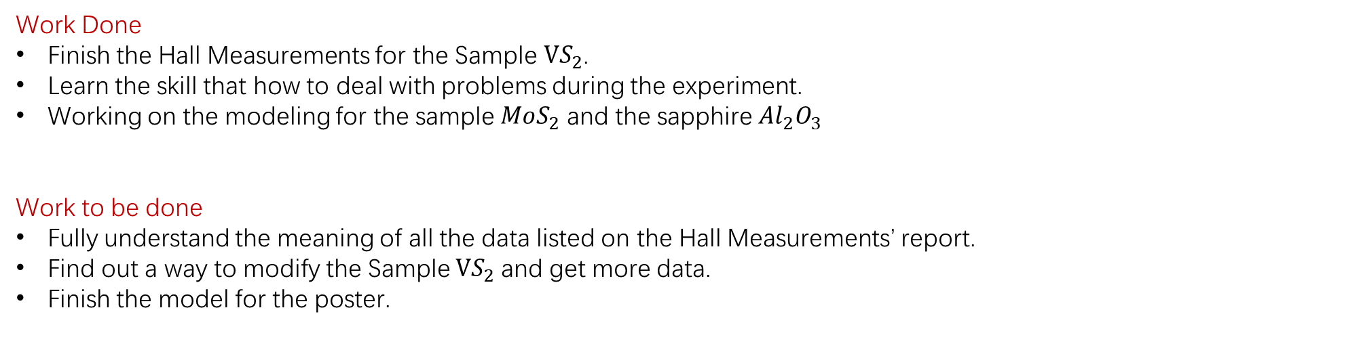
Weekly report 11/25/2019-12/1/2019 Tengteng Tao
Work Done
Finish the Hall Measurements for the Sample $VS_{2}$.
Learn the skill that how to deal with problems during the experiment.
Working on the modeling for the sample $MoS_{2}$ and the sapphire ${Al}_{2}O_{3}$
Work to be done
Fully understand the meaning of all the data listed on the Hall Measurements’ report.
Find out a way to modify the Sample $VS_{2}$and get more data.
Finish the model for the poster.
`

Slide 2
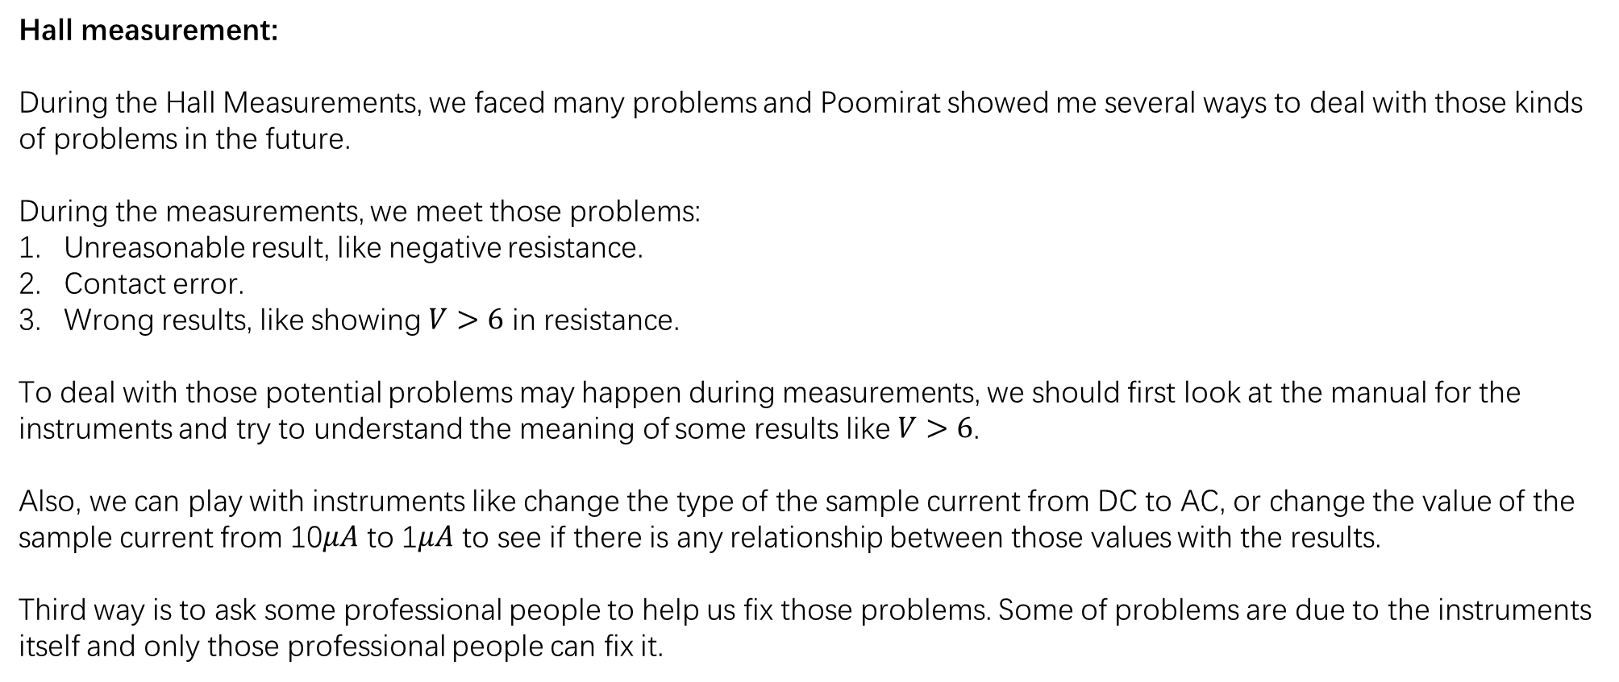
Weekly report 11/25/2019-12/1/2019 Tengteng Tao
Hall measurement:
During the Hall Measurements, we faced many problems and Poomirat showed me several ways to deal with those kinds of problems in the future.
During the measurements, we meet those problems:
Unreasonable result, like negative resistance.
Contact error.
Wrong results, like showing $V>6$ in resistance.
To deal with those potential problems may happen during measurements, we should first look at the manual for the instruments and try to understand the meaning of some results like $V>6$.
Also, we can play with instruments like change the type of the sample current from DC to AC, or change the value of the sample current from 10$μA$ to 1$μA$ to see if there is any relationship between those values with the results.
Third way is to ask some professional people to help us fix those problems. Some of problems are due to the instruments itself and only those professional people can fix it.
`

Slide 3
Weekly report 11/25/2019-12/1/2019 Tengteng Tao
Attention during the measurements:
We should set proper testing values like sample current for different samples. For our measurement, the sample is really tiny and we should start with small sample current in order to protect the sample.
We also need to control variables to provide us with some more persuasive results. Once we finished those measurements for one figuration, we should try another figuration and do the same measurements to make the measurements more accurate.
In our measurements, we tried two figurations and used three different sample current for each figurations.
`

Slide 4
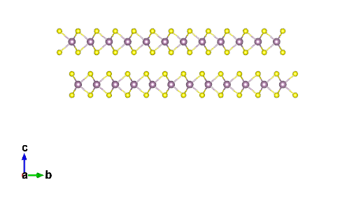
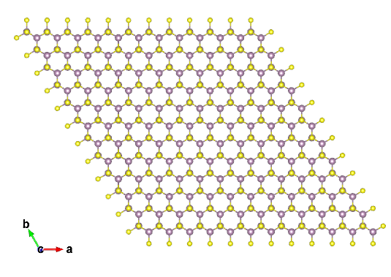
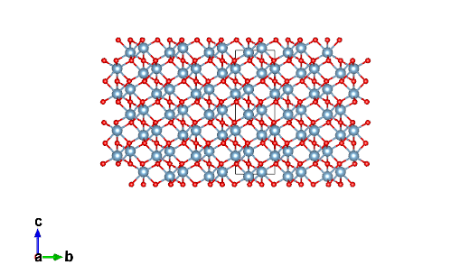
Weekly report 11/25/2019-12/1/2019 Tengteng Tao
Model:
MoS2 front view
MoS2 Top view
Al2O3 front view

